Slide 1
SECURE DATA HIDING IN IMAGES USING STEGANOGRAPHY
PRESENTED BY : P.SAI KUMAR REDDY
STUDENT NAME: P. SAI KUMAR REDDY
COLLEGE NAME : SREE VIDYANIKETHAN ENGINEERING COLLEGE
DEPARTMENT: COMPUTER SCIENCE AND SYSTEM ENGINEERING

Slide 2
OUTLINE
Problem statement
Technology used
Wow factor
End users
Result
Conclusion
Git-hub link
Future scope

Slide 3
PROBLEM STATEMENT
This project aims to develop a secure and efficient image-based steganography system that allows users to hide and extract sensitive data within digital images. The system should ensure:
Confidentiality: Hidden data should be imperceptible to unauthorized users.
Robustness: The embedded data should withstand common image processing operations like compression and resizing.
Security: The system should incorporate encryption to enhance protection against steganalysis.
Efficiency: The method should minimize distortion in the cover image while maximizing payload capacity.

Slide 4
TECHNOLOGY USED
Technologies and Methods Used in Image Steganography
Least Significant Bit (LSB) Substitution
Discrete Cosine Transform (DCT) Steganography
Discrete Wavelet Transform (DWT) Steganography
Pixel Value Differencing (PVD)
Deep Learning-Based Steganography
Adaptive Steganography
Open cv

Slide 5
WOW FACTOR
To secure data hiding in images using steganography, consider these enhancements:
1. Advanced Encryption + Steganography
2. AI-Powered Steganography
3. Multi-Layer Steganography
4. Real-Time Extraction via AR/VR
5. Blockchain Integration for Tamper-Proofing

Slide 6
END USERS
Secure data hiding in images using steganography allows end users to conceal sensitive information within digital images. This technique ensures privacy and confidentiality by embedding secret data in such a way that it remains invisible to the human eye. Here’s an overview of how end users can benefit from and use steganography:
1. How It Works
Encoding: The secret data (text, file, or another image) is embedded into an image file (carrier image) using steganographic algorithms.
Decoding: The recipient extracts the hidden message using the same algorithm and a decryption key if encryption was used.
2. Methods of Steganography
Least Significant Bit (LSB) Insertion: Modifies the least significant bits of pixel values to encode data.
Discrete Cosine Transform (DCT): Hides data in the frequency domain of images (used in JPEG compression).
3. End-User Applications
Secure Communication: Individuals can share confidential information covertly.
Authentication & Digital Signatures: Helps verify authenticity by embedding metadata.
Forensics & Intelligence: Used in cyber forensics to track digital evidence.
4. Security Considerations
Encryption Before Embedding: Encrypting data before hiding enhances security.
Detection & Steganalysis Resistance: Using complex algorithms reduces the risk of detection.

Slide 7
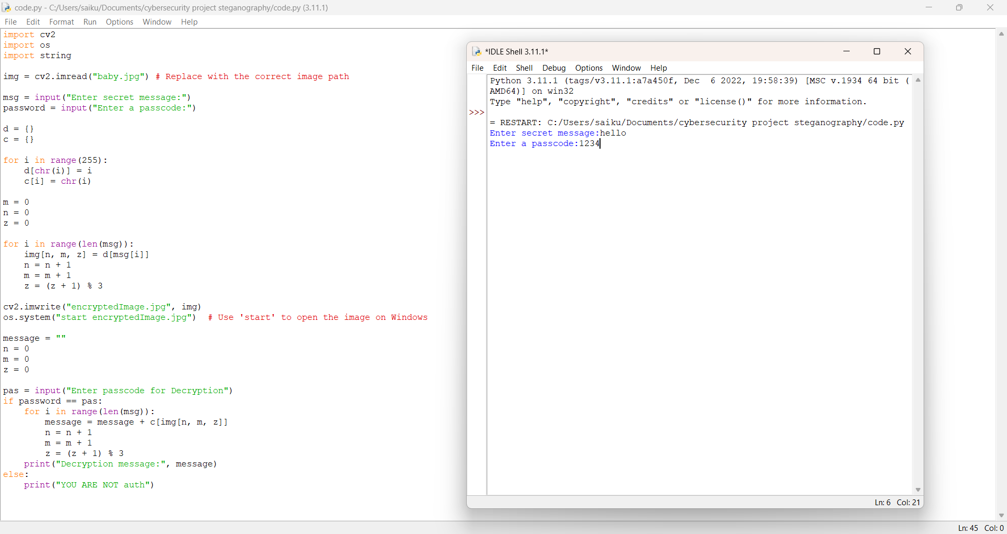
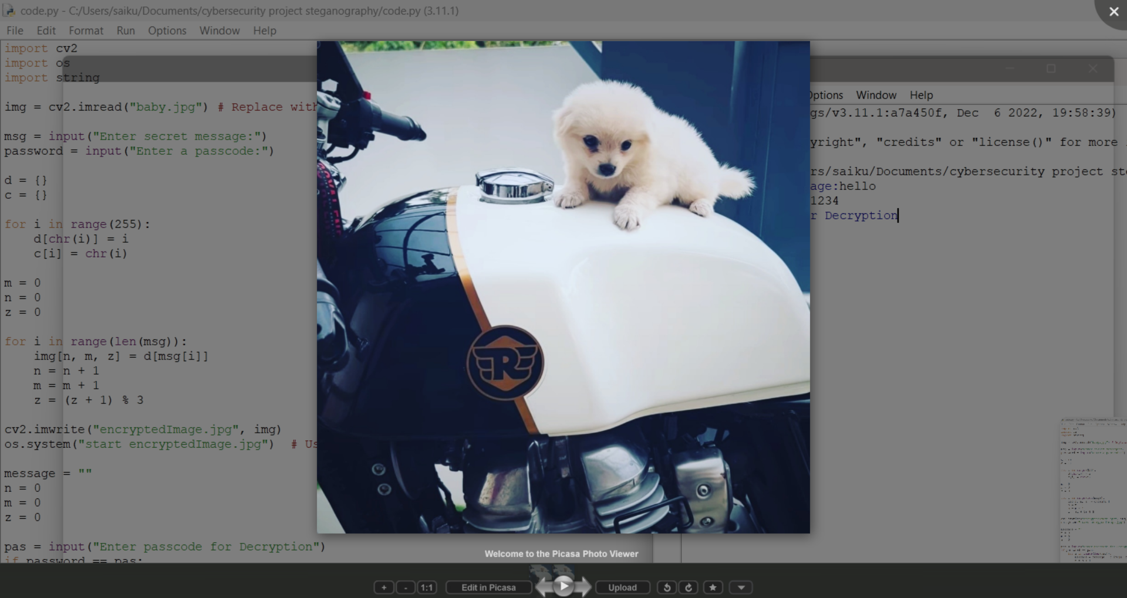
RESULT

Slide 8
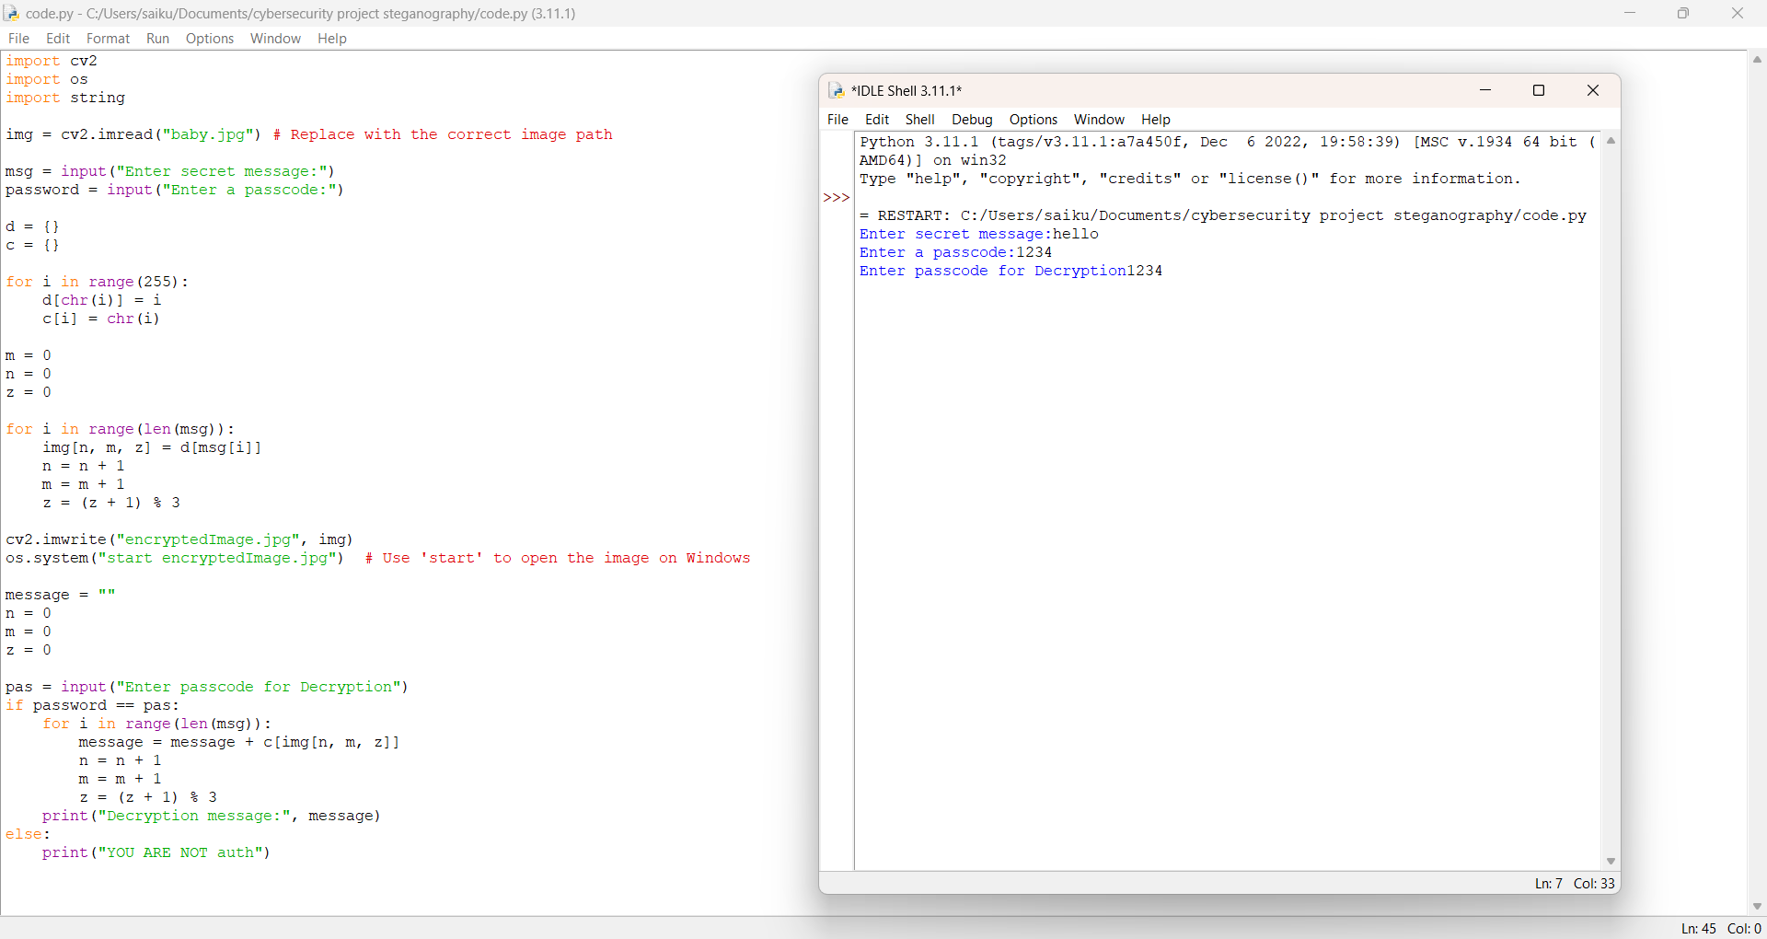
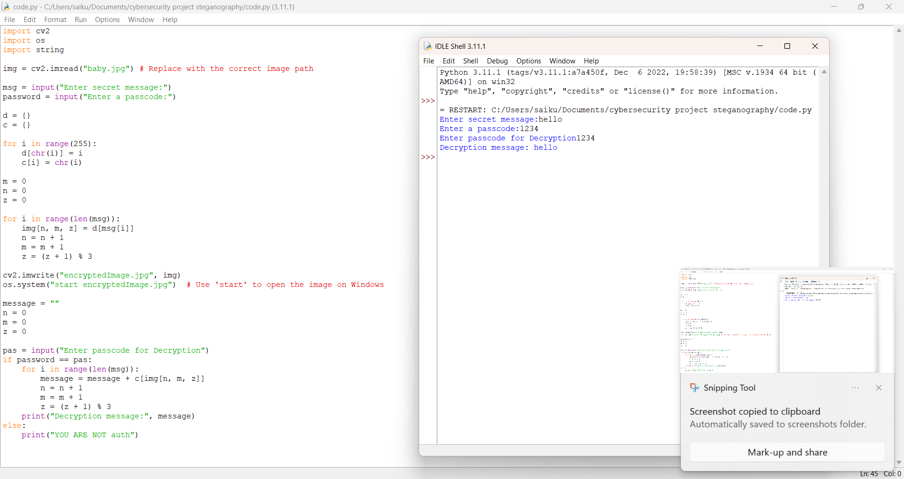
RESULT

Slide 9
CONCLUSION
Steganography is a powerful technique for securely hiding data within images, ensuring confidentiality and reducing the risk of detection. By embedding information in an image without significantly altering its appearance, steganography provides a covert communication channel that enhances data security.
Modern steganographic methods utilize various encoding techniques, such as Least Significant Bit (LSB) substitution, frequency-domain transformations, and cryptographic enhancements, to improve robustness and resistance against detection or attacks. While steganography offers significant advantages in secure data transmission, it is not foolproof. If improperly implemented, it can be vulnerable to steganalysis techniques that detect hidden data.
To maximize security, steganography is often combined with encryption, ensuring that even if hidden data is discovered, it remains protected. As technology advances, research in steganographic techniques continues to evolve, enhancing their effectiveness in cybersecurity applications, digital watermarking, and confidential communication.
In conclusion, steganography remains a valuable tool for secure data hiding, provided it is used with strong algorithms and complementary security measures.

Slide 10
GIT-HUB LINK:
https://github.com/PuchaSai9/secure-data-hiding-in-images-using-steganography.git
GIT-HUB PROFILE:
https://github.com/PuchaSai9

Slide 11

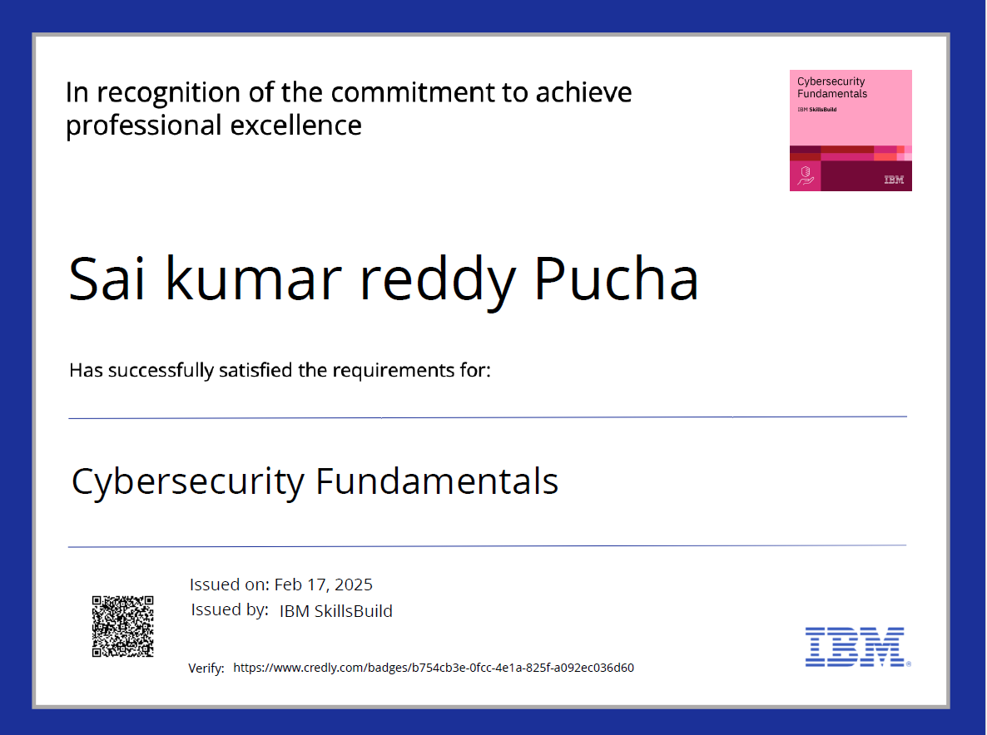
IBM COURSE CERTIFICATE

Slide 12
FUTURE SCOPE
Steganography, the practice of hiding data within images, has seen significant advancements in recent years. As technology evolves, its future scope is expanding in various fields, including cybersecurity, digital forensics, and secure communications.
1. Advanced Encryption Integration
2. AI and Machine Learning in Steganography
3. Quantum Steganography
4. Blockchain-Based Steganography
5. Cloud-Based Steganographic Storage
6. Enhanced Steganalysis Resistance
7. Real-Time Steganography Applications
8. High-Capacity Data Hiding Techniques
9. Mobile and IoT Security
10. Ethical and Legal Considerations

Slide 13
THANK YOU

